Slide 1
CS 129.18
Naive Bayes Classifiers

Slide 2
Conditional Probability
P(A ∩ B)
P(A | B) =
P(B)
Probability of A happening, given B happened

Slide 3
Conditional Probability
Probability A and B occurs
P(A ∩ B)
P(A | B) =
P(B)
Probability of A happening, given B happened

Slide 4
P(B)
P(A)
Ratio of the intersection of A and B, with probability of B happening

Slide 5
The percentage of adults who are male and alcoholic are 2.25%. What is the probability of being an alcoholic, given being a man?
Assume: 50% probability of being a man

Slide 6
Given:
P(A) = % of being alcoholic
P(B) = % of being man
P(A∩B) = 0.0225

Slide 7
P(A ∩ B)
P(A | B) =
P(B)
P(B ∩ A)
P(B | A) =
P(A)
P(B ∩ A) is actually P(B | A) x P(A)

Slide 8
Bayes Theorem
P(B|A) x P(A)
P(A | B) =
P(B)

Slide 9
Your friend tells you that she has 2 Charmanders, and at least one of them is shiny. What is the probability that all of them are shiny?
Given:
Each Pokemon has 0.002% or 1/512 chance of being shiny

Slide 10
P(at least 1 shiny | 2 shinies ) x P(2 shinies)
P(A | B) =
P(at least 1 shiny)

Slide 11
P(B | A) is actually 100%!
1/512 * 2
P(at least 1 shiny | 2 shinies ) x P(2 shinies)
P(A | B) =
P(at least 1 shiny)
1/512

Slide 12
Approximately 1% of women aged 40-50 have breast cancer. A woman with breast cancer has 80% chance of testing positively on a mammogram, while a woman without has a 10% chance of a false positive.
What is the probability that a woman has breast cancer given that she just had a positive test?

Slide 13
Given:
P(A) = having breast cancer
P(B) = having a positive test

Slide 14

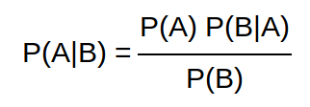
Bayes Theorem
By Thomas Bayes
Calculating the validity of beliefs (hypothesis) based on available evidence - used in solving conditional probability.
“How often A happens given that B happens, written P(A|B), when we know how often B happens given that A happens, written P(B|A) , and how likely A and B are on their own”

Slide 15
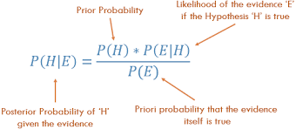
Components
Posterior Probability P(H|E)
Probability of the hypothesis given the evidence
Prior probability P(H)
Probability of hypothesis happening
Likelihood P(E|H)
Likelihood of evidence given that hypothesis is true
Priori probability / marginal probability P(E)
Probability of evidence itself

Slide 16
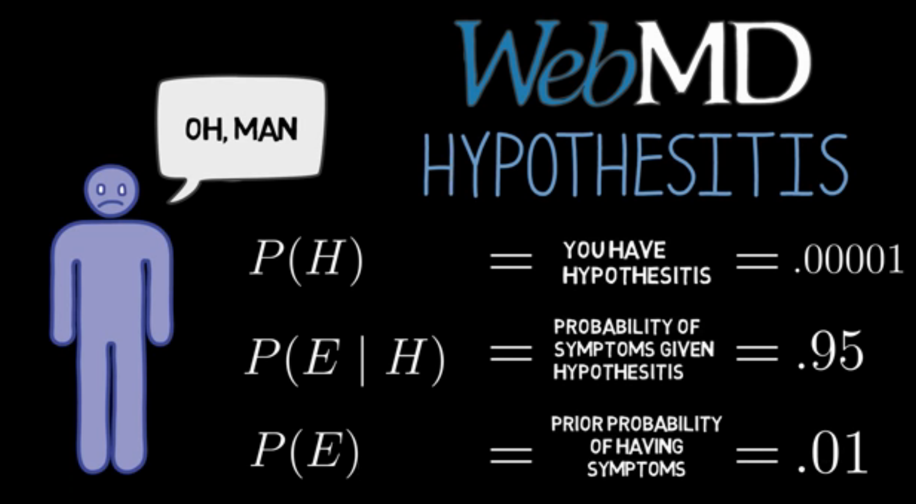
Bayes Theorem Example
From the scenario, we get:
P(H|E) = P(H) * P(E|H) / P(E)
= 0.00095
Shows that
P(H|E) != P(E|H)
Importance of the prior probabilities P(H) and P(E)

Slide 17


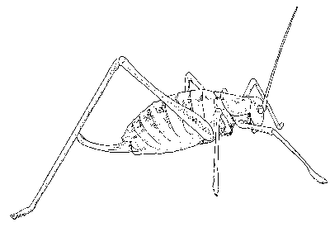
Classification Problem
We were given a collection of data: In this case 5 instances Katydids of and 5 of Grasshoppers.
Now, decide what type of insect the unlabeled example below is.
Is this Katydid or Grasshopper?

Slide 18
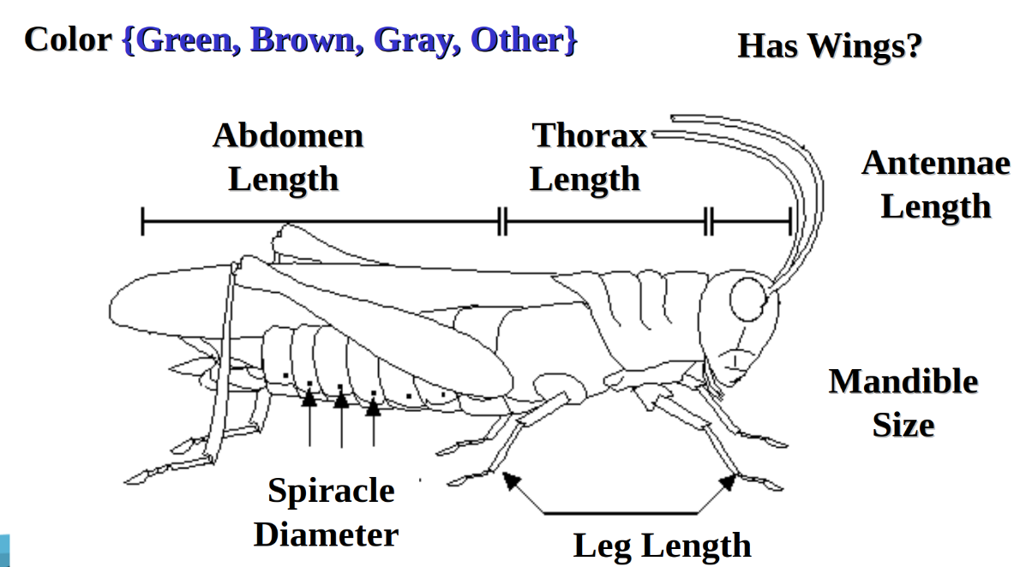
Features or Attributes

Slide 19
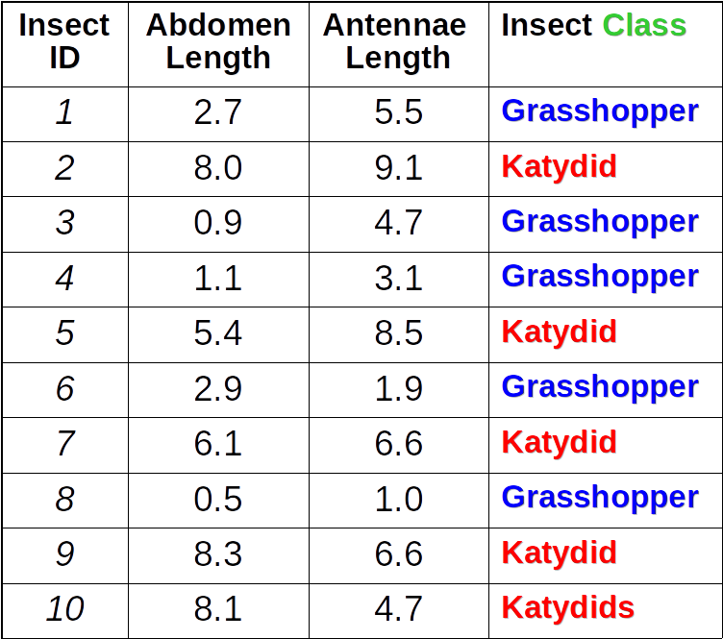
Tabulated Observations
The classification problem can now be expressed as:
Given a training table, predict the class label of a previously unseen instance:
Insect ID | Abdomen Length | Antennae Length | Insect class
11 | 5.1 | 7.0 | ???

Slide 20
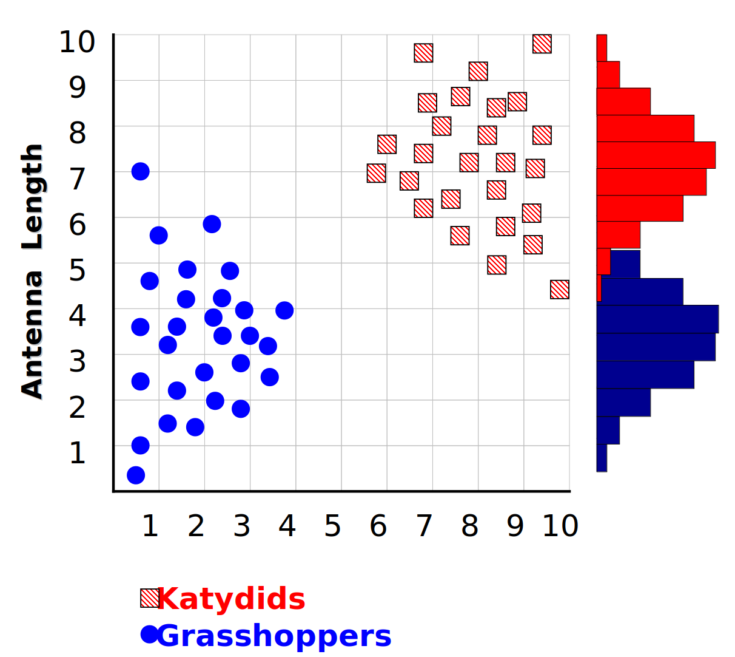
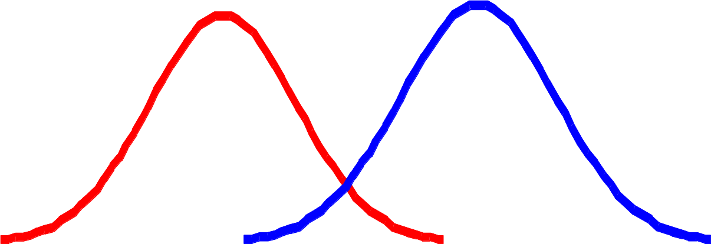

Plotting observations
We can leave the histograms as they are, or we can summarize them with two normal distributions.

Slide 21
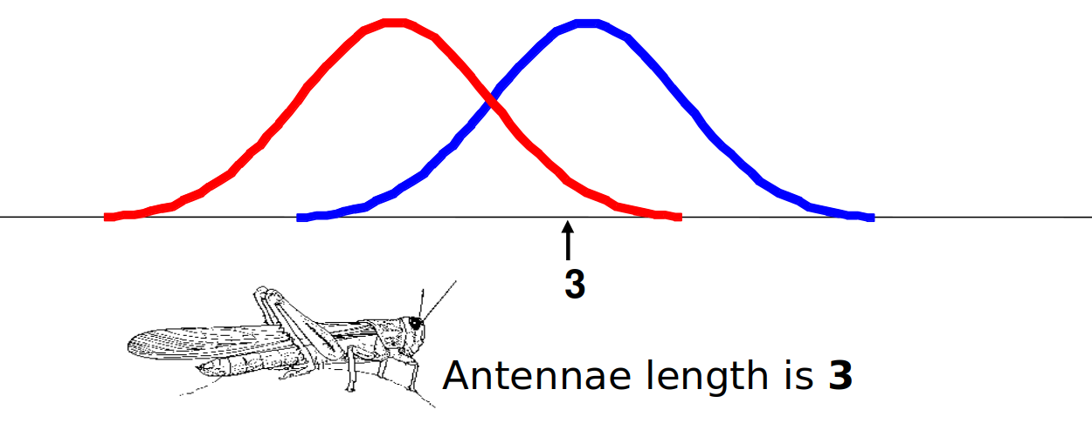
Most Probable Classification
We want to classify an insect we have found. Its antennae are 3 units long. How can we classify it?
We can just ask ourselves, give the distributions of antennae lengths we have seen, is it more probable that our insect is a Grasshopper or a Katydid.
There is a formal way to discuss the most probable classification…
p(C_{j} | d) = probability of class C_{j}, given that we have observed d

Slide 22

Bayesian classifiers use Bayes theorem:
p(C_{j} | d) is the probability of instance d being in class C_{j},
This is what we are trying to compute (Posterior Probability)
p(d | C_{j}) is the probability of generating instance d given class C_{j},
We can imagine that being in class C_{j}, causes you to have feature d with some probability (Likelihood)
p(C_{j}) is the probability of occurrence of class C_{j} ,
This is just how frequent the class C_{j} , is in our database (Prior Probability)
p(d) is the probability of instance d occurring
This can actually be ignored, since it is the same for all classes (Evidence)
`

Slide 23
Bayes Classifiers
Consider each attribute and class label as random variables
Given a record with attributes (A₁, A₂,…,A_{n})
Goal is to predict class C
Specifically, we want to find the value of C that maximizes P(C| A₁, A₂,…,A_{n} )
Can we estimate P(C| A₁, A₂,…,A_{n} ) directly from data?

Slide 24
Naive Bayes Classifiers
Assume independence among attributes Ai when class is given:
P(A₁, A₂, …, A_{n} |C) = P(A₁| C_{j}) P(A₂| C_{j})… P(A_{n}| C_{j})
Able to estimate P(A_{i}| C_{j}) for all A_{i} and C_{j}.
New point is classified to C_{j} if P(C_{j}) P(A_{i}| C_{j}) is the maximum.

Slide 25
Naive Bayes Classifiers
To simplify the task, naïve Bayesian classifiers assume attributes have independent distributions, and thereby estimate
p(d|c_{j}) = p(d₁|c_{j}) * p(d₂|c_{j}) * ….* p(d_{n}|c_{j})
The probability of class c_{j} generating the observed value for feature 2, multiplied by..
The probability of class c_{j} generating instance d, equals….
The probability of class c_{j} generating the observed value for feature 1, multiplied by..

Slide 26
Spam Detection
NBC for Spam

Slide 27
Bayes Theorem
P(words|spam) x P(spam)
P(spam | words) =
P(words)

Slide 28
Thank you

